Slide 1

Face Mask detection
Deep learning – GIn515
Presented by:
Anthony El Chemaly
Catherina El Khoury
Edmond Samia
Presented to:
Dr. Hayssam Serhan

Slide 2
AGENDA
Introduction
Dataset
Libraries
Python Code
Results

Slide 3
INTRODUCTION
In this project, our aim is to create a program that uses a dataset, OpenCV, Keras with TensorFlow and other libraries to detect whether a person is wearing a mask or not.

Slide 4
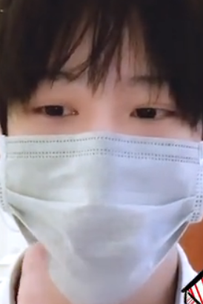
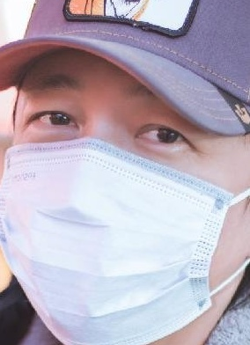
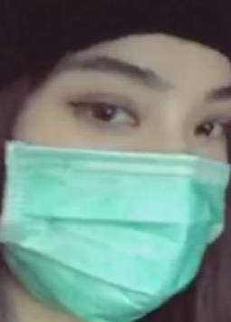
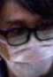
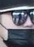
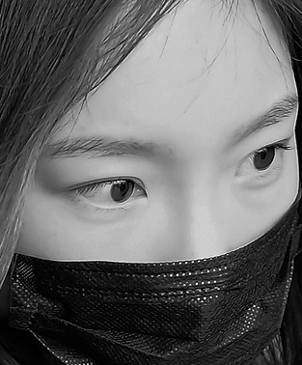
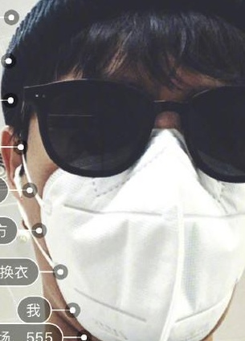
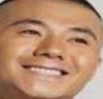
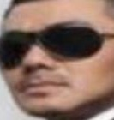
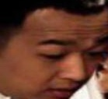
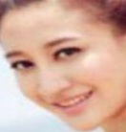
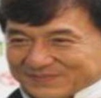
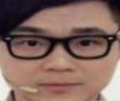
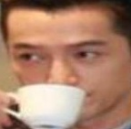
DATASET
Our dataset includes various images featuring people, captured both with and without masks.

Slide 5
Libraries used in our project
OS
OpenCV (cv2)
Tensorflow (tf) - Keras
Shutil
Numpy

Slide 6
OpenCV
It is used for tasks such as image and video processing, object detection, feature extraction, and more.
For example, we used it in our project for real-time video processing.
cap = cv2.VideoCapture(0)

Slide 7
Code..

Slide 8
Results (Video capture conditions)

Slide 9
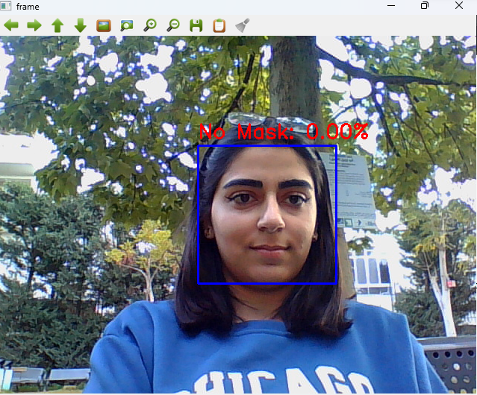
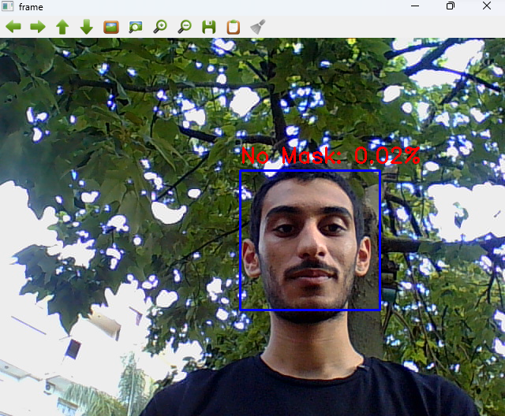
2 different people without masks in the same conditions

Slide 10
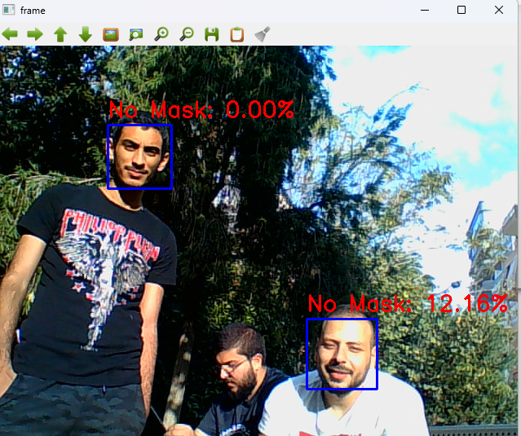
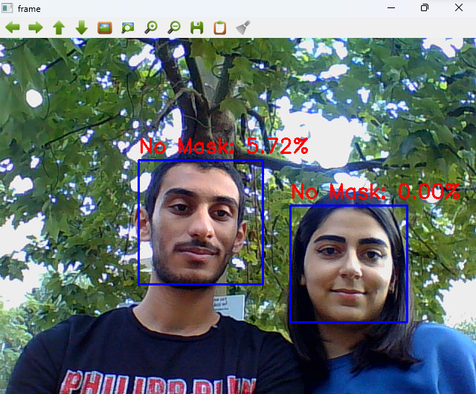
Multiple people in different lighting conditions

Slide 11
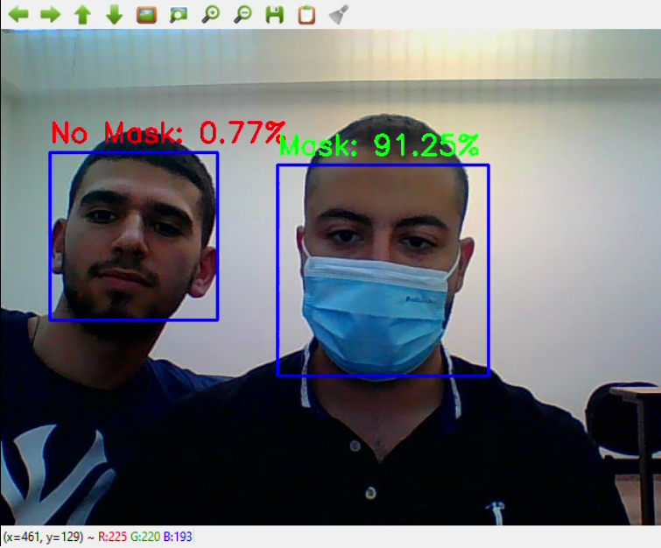
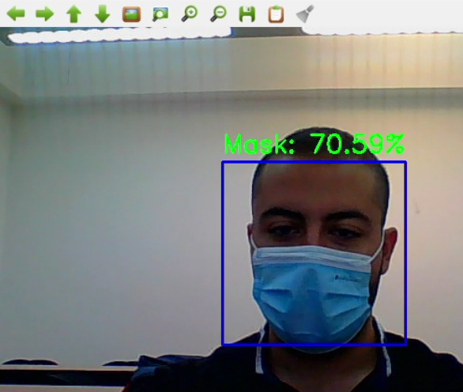
Different mask results

Slide 12
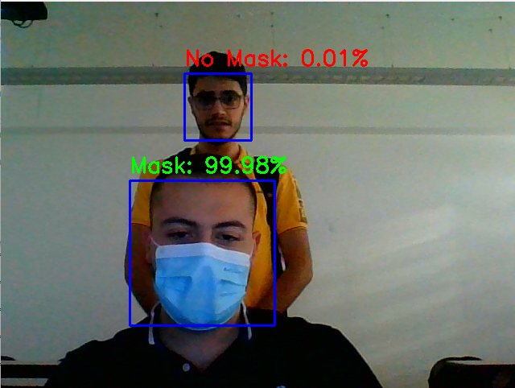
Bad lighting

Slide 13
THANK YOU

